Slide 1
Privacy Mechanisms in Federated Learning Problems
- Sundaresan G
Ajeya B S
Find the code here

Slide 2
Introduction/Motivation
Federated learning poses significant challenges to privacy and security, as the data is distributed among multiple clients, and the training process involves communication between clients and a central server.
This creates the risk of exposing sensitive information about individuals' data to unauthorized parties.
To address these privacy concerns, privacy mechanisms are needed to ensure privacy-preserving federated learning.
These techniques should protect data privacy while trying to maintain the accuracy and performance of the federated learning process.
In this presentation, we will show the effects of applying privacy mechanisms in the FedML Library.

Slide 3
Related Work
1) "A Hybrid Approach to Privacy-Preserving Federated Learning" presents an alternative approach to federated learning that utilizes both differential privacy and secure multiparty computation to balance the trade-offs between privacy and accuracy. But the implementation is not on Tier based FL, which we approach.
2) Pyfhel is a Python library for fully homomorphic encryption (FHE). FHE is a powerful encryption technique that enables computations to be performed on encrypted data without the need for decryption. The library includes functionality for basic arithmetic operations on encrypted data, as well as comparison, input/output, and serialization functionalities.
3) TIFL, a Tier-based Federated Learning System, divides clients into tiers based on some measure metrics that help profile the device, then selects one tier per round and trains data using an adaptive algorithm that helps tackle both data and device-heterogeneity.

Slide 4
Technical Design
We work with two models - CNN and LR for the dataset MNIST.
CNN has a total of 1206590 parameters and LR has a total of 7850 parameters summed over all weights and biases.
We experiment with two privacy mechanisms - Homomorphic Encryption and Differential Privacy.
We take the aid of Pyfhel for homomorphic encryption and the Laplace distribution to add noise in differential privacy.

Slide 5
Implementation - TiFL
The majority of changes we make in the fedavg_api script.
Before the changes for privacy mechanisms are added, we noticed a few changes needed in the fedavg_api script.
Removed the hard-coding of number of clients (data_loader.py). This ensures that testing is also carried out only on selected clients.
Clients are divided into tiers in the very beginning using threshold values based on their data size. The threshold is set such that each tier has nearly equal clients.
Tier accuracy is evaluated for assigning tier probabilities.

Slide 6
Homomorphic Encryption
Homomorphic Encryption is a privacy technique that allows computations to be performed on encrypted data without decrypting it, thereby maintaining data confidentiality.
Homomorphic Encryption achieves this by transforming plaintext data into a ciphertext that can be operated on using mathematical operations, without revealing any information about the plaintext data to the party performing the computation.
Pyfhel uses FHE. We choose this over PHE because other than better security, it allows for both addition and multiplication operations to be performed on encrypted data. As FHE is a complete encryption scheme, meaning that it can be used to perform any computation on the encrypted data, regardless of the complexity of the computation.
One disadvantage of using FHE over PHE libraries is the extra computational complexity and more bandwidth consumption. But given the advantages, and possible future complex operations on the data, we go ahead with FHE.

Slide 7
Differential Privacy
Differential Privacy is a privacy technique that adds noise to the data to prevent the leakage of sensitive information about individuals, thereby preserving data privacy while still allowing useful information to be extracted from the data.
We use the Laplace distribution for adding noise to data, which is a double exponential distribution. So this gives us the combinations of both Gaussian distribution - that is, it is symmetric, and the Exponential distribution - that it can model heavy-tailed distributions, which are common in real-world data.
The sensitivity parameter is something that needs to be chosen with care, and a high sensitivity gives a bad accuracy and a low sensitivity does not mask the data enough. We talk about the values chosen more in the implementation section.

Slide 8
Implementation - Privacy Mechanism
Under homomorphic encryption, we use the CKKS scheme for encryption. While there are other schemes like BFV and BGV, they work better on Integers and we want encryption on real numbers.
CKKS (the "Cheon-Kim-Kim-Song" scheme) is a homomorphic encryption scheme that allows computations on encrypted data in the context of the Real numbers (or Complex numbers). Hence we choose that scheme for encryption.
In CKKS scheme, the polynomial modulus degree to be set is such that if n is the polynomial degree, then n/2 values can be encoded in a ciphertext.

Slide 9
Implementation - Privacy Mechanism
For CNN,there are a total of 8 keys in the model,which are the bias and weights for each of the 4 layers.
The number of parameters in linear1.weight are more than a million while no other keys do not have less than 20,000 parameters. The number of parameters is around 18000 for conv2d_2.weight. This is just above 2¹⁴.
We chose keep the modulus degree same for all keys, which makes the encrypted weights harder to decode. If we have to encrypt all the weights, it would involve encrypting the keys with modulus degree greater 2²², which would greatly increase the aggregation time, the encryption and decryption time, the overall size and hence the network bandwidth. So we encrypt 6 of the 8 keys by setting n as 2¹⁴.

Slide 10
Implementation - Privacy Mechanism
The sensitivity of a function f is the amount f’s output changes when its input changes by 1.
The scale of the noise will be calibrated to the sensitivity of f (input))/ε.
So this would mean that more sensitive the input, more noise would be added.
Instead of setting hard coded numbers as input, we make the sensitivity as a function of the input data. As a base, choose average of the difference of the array. We do not choose min or max as that would make the sensitivity skewed.
Setting sensitivity to only the mean of diffs leads to a high noise being added leading to bad accuracy. After a few trials, we find mean/20 to be a good parameter for the two models we test on - CNN and LR.

Slide 11
Experiments
In this study, Federated Learning environment is simulated on a single computer with GPU. As mentioned earlier, privacy preserving schemes are implemented on top of TiFL and the experiments are performed on datasets MNIST with models LR and CNN.
We experiment with different number of clients and change the number of clients per round and also the number of communication rounds.
We observe that without encryption, the accuracy starts to stabilize after 50-60 rounds.

Slide 12
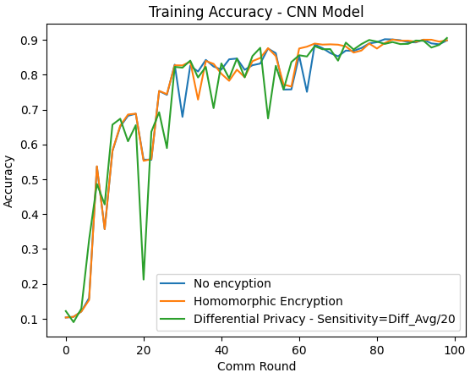
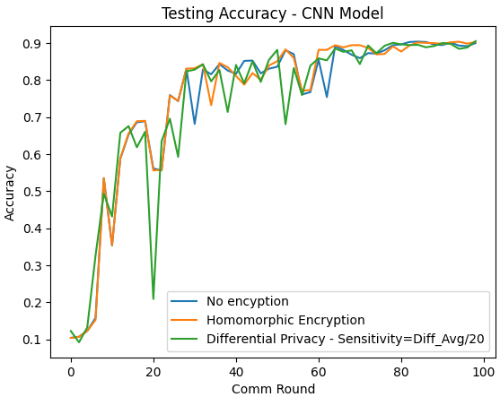
Experiments
For comparison between the privacy mechanisms, we set clients to 1000 and clients per round to 20. Below are the results :
CNN

Slide 13
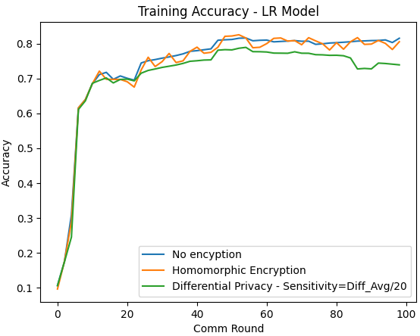
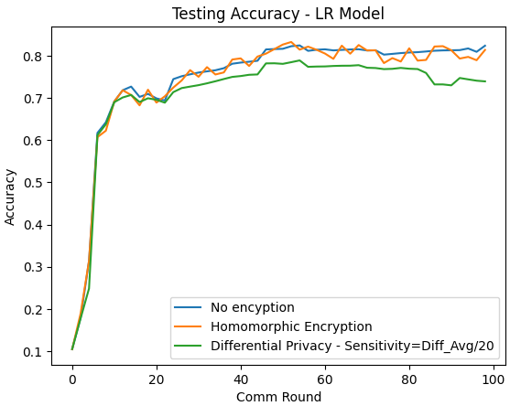
Experiments
LR

Slide 14
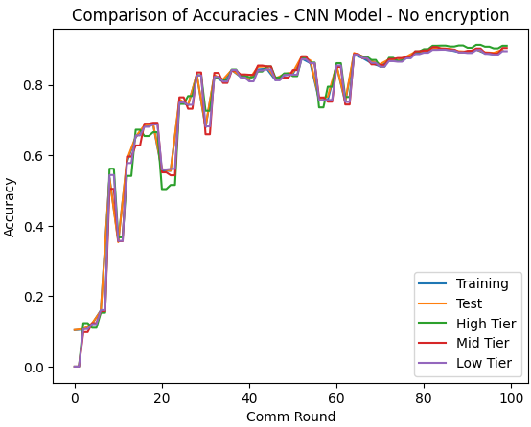
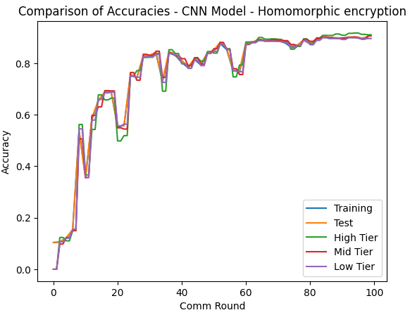
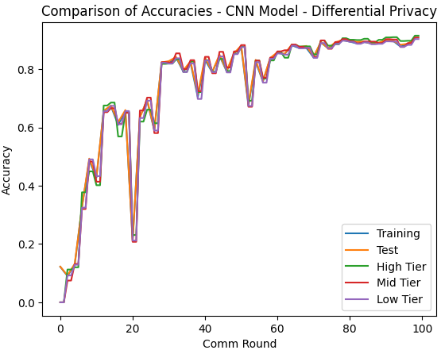
Experiments
Comparison of accuracies with Tier Accuracies: CNN Model

Slide 15
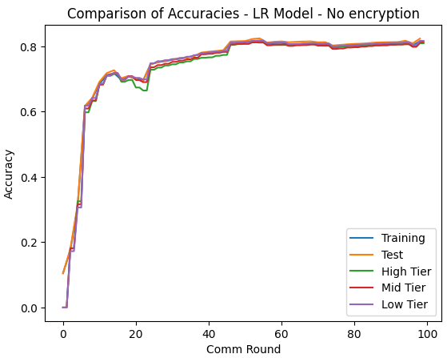
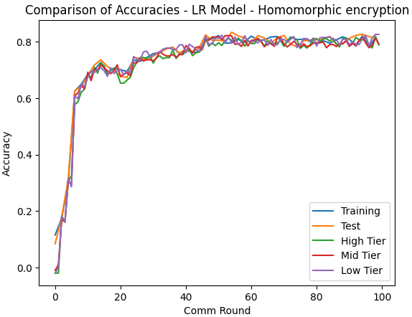
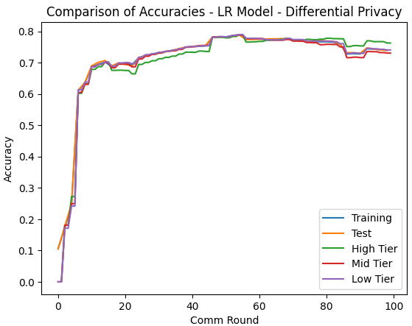
Experiments
Comparison of accuracies with Tier Accuracies: LR Model

Slide 16
Experiments
Data before and after adding Noise with scale as sensitivity/20
CNN:
Before adding noise:
-0.08796778321266174
-0.03165837377309799
-0.21958641707897186
0.0772828683257103
0.09209869801998138
.
.
.
0.05218728631734848
0.10821180790662766
0.060969430953264236
After adding noise:
-0.10444337335823564
-0.02420701100452497
-0.22669787717010317
0.06431537891579146
0.08795420913983709
.
.
.
0.05765671311485264
0.08761235394229525
0.06578364324710248
LR:
Before adding noise:
-0.05089318007230759
-0.019038140773773193
-0.030130337923765182
-0.008100875653326511
-0.06230921298265457
-0.06513626128435135
-0.011700395494699478
-0.034777767956256866
-0.0012088366784155369
-0.031103404238820076
After adding noise:
-0.051743661119062866
-0.01821901295152807
-0.02979546386159782
-0.007963980712770984
-0.0625503724234304
-0.06363409840906788
-0.011894459453856901
-0.03255031390670931
0.0026071251286637538
-0.03048972274240148

Slide 17
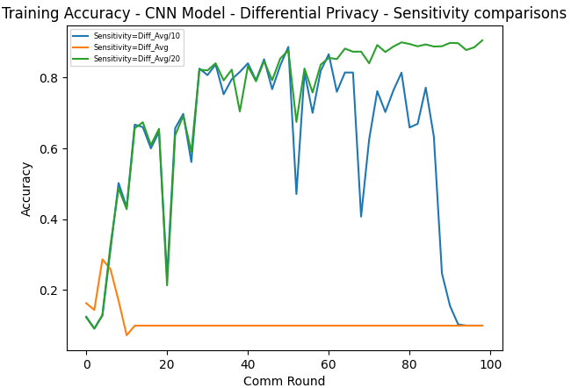
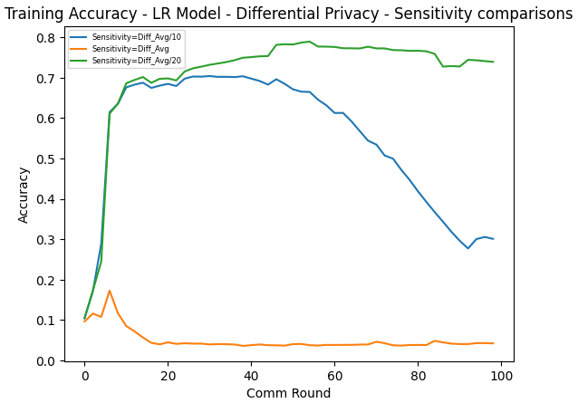
Experiments
Comparison of Differential Privacy with different scale values

Slide 18
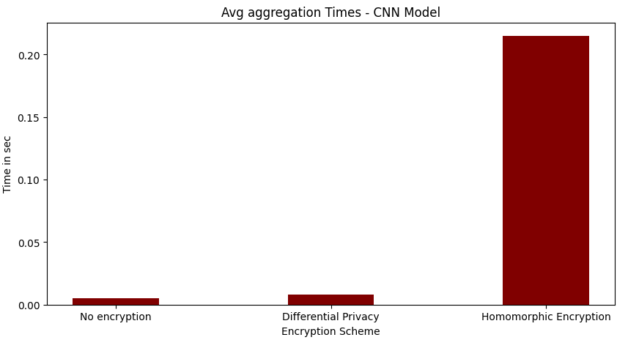
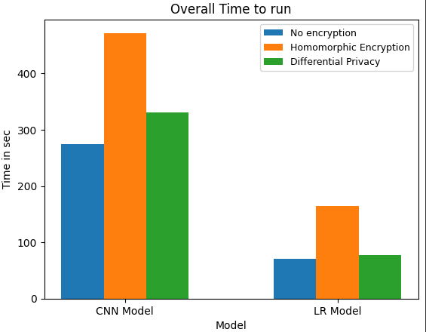
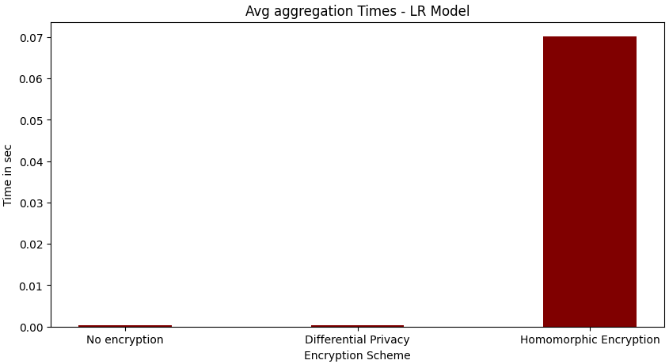
Experiments

Slide 19
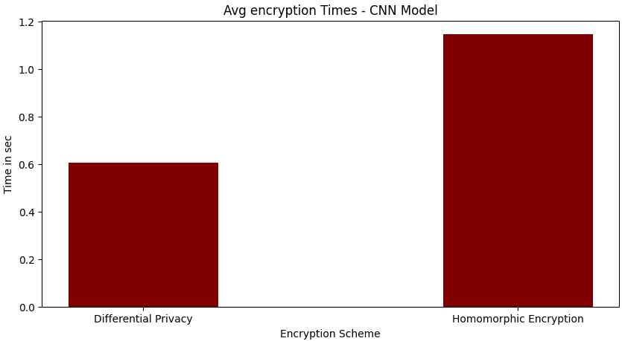
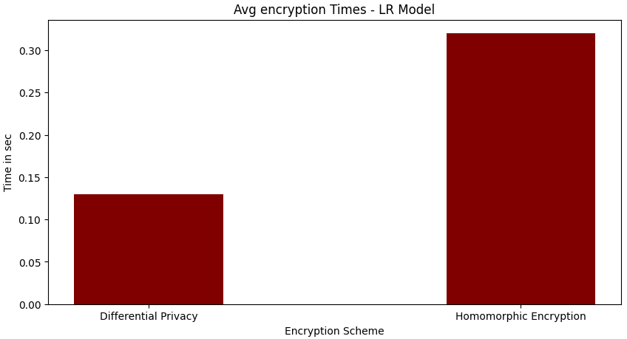
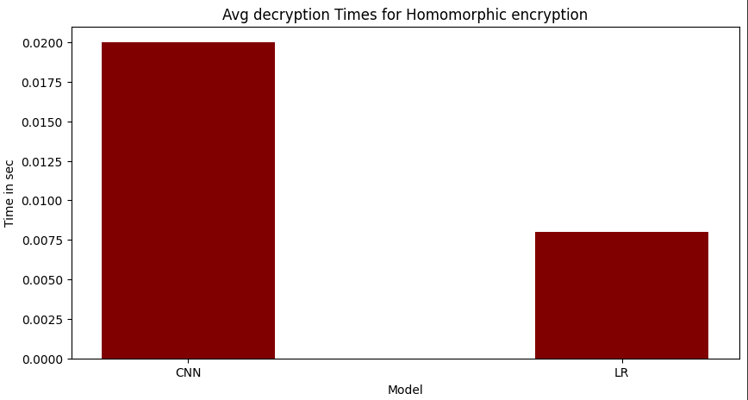
Experiments

Slide 20
Analysis of Results
Tierwise accuracies match well with global accuracy in all cases.
Homomorphic encryption accuracy is similar to no encryption, however the overall time is increased by 72% and 100% in CNN and LR respectively.
Also HE leads to 3.36% and 108% increase in communication bandwidth for CNN and LR respectively.
Aggregation and encryption time is highest for HE.
Differential privacy is susceptible to sensitivity values and may lead to divergence.

Slide 21
Conclusion
Both Homomorphic Encryption and Differential Privacy schemes apply well as an additive to TiFL.
Homomorphic encryption (on partial weights) does not affect the accuracy or convergence, but the overall time taken increases, and also increases the bandwidth.
Differential Privacy, though provides a similar overall time as no encryption, it is highly dependent on sensitivity specified.
So, if the requirement is more towards time with a smaller level of privacy acceptable, use DP, and if higher time and network is tolerable, use Homomorphic

Slide 22
Future Work
Implement more privacy mechanisms like Oblivious Transfer, SMC and see the effects
Hybrid privacy mechanisms like in "A Hybrid Approach to Privacy-Preserving Federated Learning" in Tier Based FL and compare its performance with what we have implemented.
Try the privacy mechanisms on asynchronous Tier Based FLs like FedAT.

